Slide 1

Analysis of Hospital Distribution by ZipCode in New Jersey, USA
Mala Mehta

Slide 2
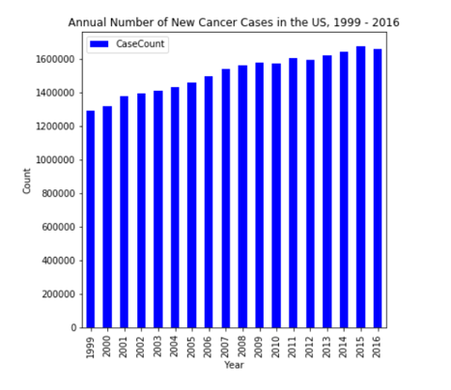
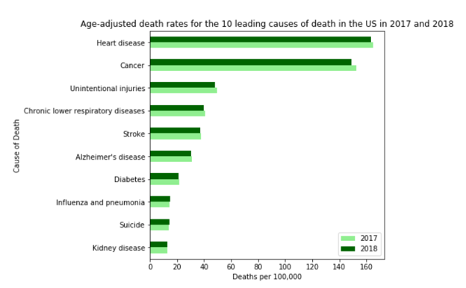
Background
Cancer is the second leading cause of death in the Unites States
The number of cancer cases year over year has been steadily rising

Slide 3
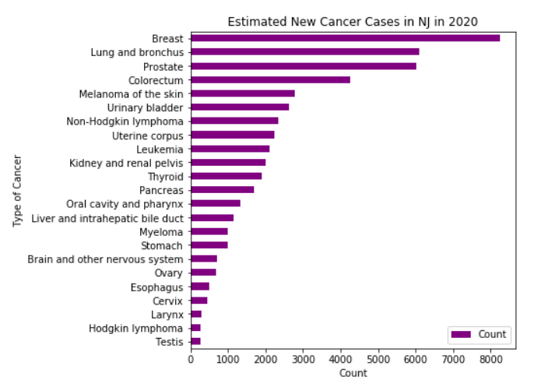
Problem
Cancer Hospitals USA (a fictitious group) is a group of premier cancer hospitals
In 2020, an estimated 53,340 new cases of cancer are expected to occur in NJ
Cancer hospitals USA intends to open a brand-new state-of-the-art hospital in NJ

Slide 4
Data Sources and Cleaning
New Jersey zip code and latitude/longitude data from https://public.opendatasoft.com. A CSV file was downloaded from the OpenDataSoft website and loaded into a Pandas dataframe. Unneeded columns were dropped.
Population data for zip codes in New Jersey https://www.newjersey-demographics.com. Web scraping methodology was employed. After loading into a Pandas dataframe, 1 column was dropped and another was renamed to match the column name in the latitude/longitude dataframe.
Leading causes of death in the US https://www.cdc.gov. Data was manually entered into a spreadsheet and then loaded into a Pandas dataframe.
US Cancer Statistics Year Over Year Trend https://gis.cdc.gov. A CSV file was downloaded, nonessential columns were removed and data was formatted appropriately. The CSV file was then loaded into a Pandas dataframe.
New Jersey 2020 Estimates https://cancerstatisticscenter.cancer.org. A CSV file was downloaded and only data for the state of NJ was retained. Non-required columns were deleted and any rows that were missing counts of no. of cases were removed as well. The data was then loaded into a Pandas dataframe.

Slide 5
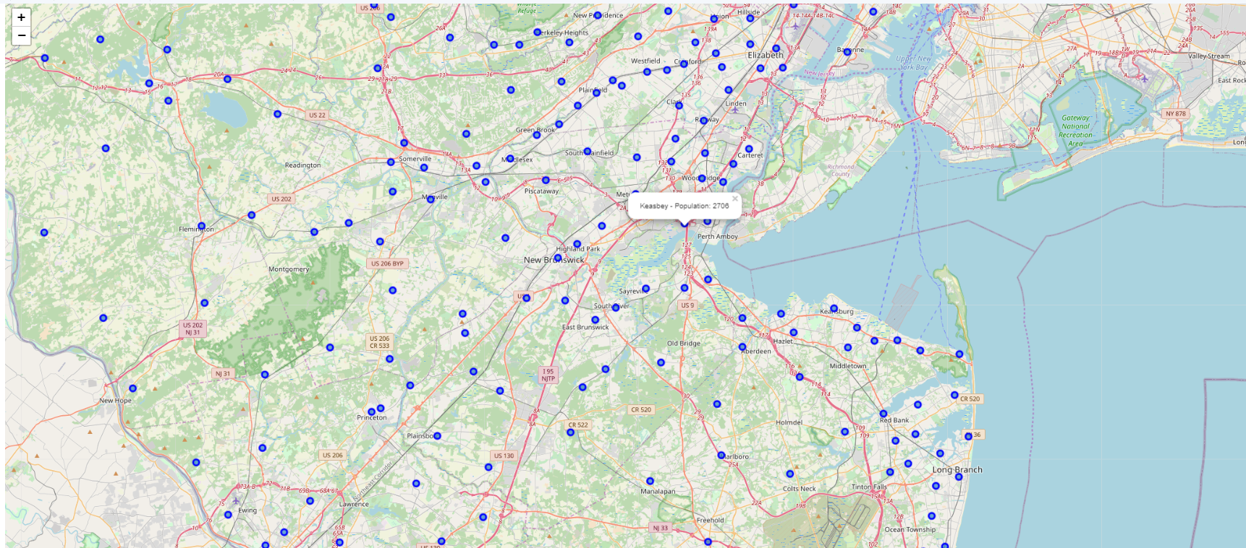
Methodology
Merge the NJ latitude/longitude and population data into 1 dataframe
Draw a Folium map to show different zip codes based on latitude and longitude values and display markers showing the city and population
Use the FourSquare API to search for Medical Centers in NJ
Clean the data to retain only categories relevant to the analysis

Slide 6
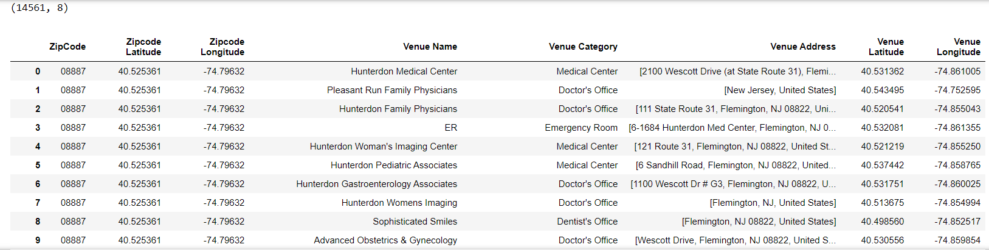
Clean the data to retain only categories relevant to the analysis

Slide 7
Results and Conclusion
Use K-Means clustering to divide the data into 5 clusters and analyze each one of them
Parameters used – latitude and longitude of each zipcode and a radius of 5000 meters
Cluster # 1 has the highest number of zip codes with hospitals
Cluster # 2 has a preponderance of medical centers
Cluster # 3 has a mix of medical centers and emergency rooms
Cluster # 4 has a preponderance of medical centers
Cluster # 5 has both medical centers and urgent care centers
Cancer Hospitals USA can use this data along with real estate cost, easy access from major highways and rail stations and other relevant factors to pinpoint the ideal location for the new hospital.

